Slide 1
Exploring Object Detection Capabilities
From UAV Aerial Perspectives with Deep Learning Tools

Slide 2
Introduction
Unmanned Aerial Vehicles (UAVs) are widely used in traffic monitoring, surveillance, and disaster relief.
Challenges in aerial object detection include varying object scales, cluttered environments, and altitude variations.
Aims:
Develop a Reliable Detection System:
Build a YOLO-based detection system to accurately identify objects in UAV imagery, optimized for performance and accuracy using the VisDrone dataset.
Achieve Real-Time Detection Performance:
Extend the system to process live video feeds with real-time capabilities, integrating object tracking and interactive features for practical UAV applications.

Slide 3
Project Workflow
Dataset Preparation
Model Selection (YOLOv11n vs YOLOv11x)
Hyperparameter Optimization
Real-Time Detection Development
Testing and Evaluation

Slide 4
Challenges and Solutions
Dataset Label Formatting:
Problem:
Raw labels’ annotations incompatible with YOLO.
Solution:
Custom script to normalize and reformat labels.
Tracking and Frame Drops:
Problem:
YOLO's official tracking code caused frame drops.
Solution:
Code optimization and bug fixes improved performance.
Object Locking:
Problem:
Initial object tracking and movement direction relied on trajectory-based feedback, which lacked a reference point and resulted in ineffective tracking.
Solution:
Modified the strategy to use the camera's center as a reference point, enabling more accurate object locking and movement direction.

Slide 5
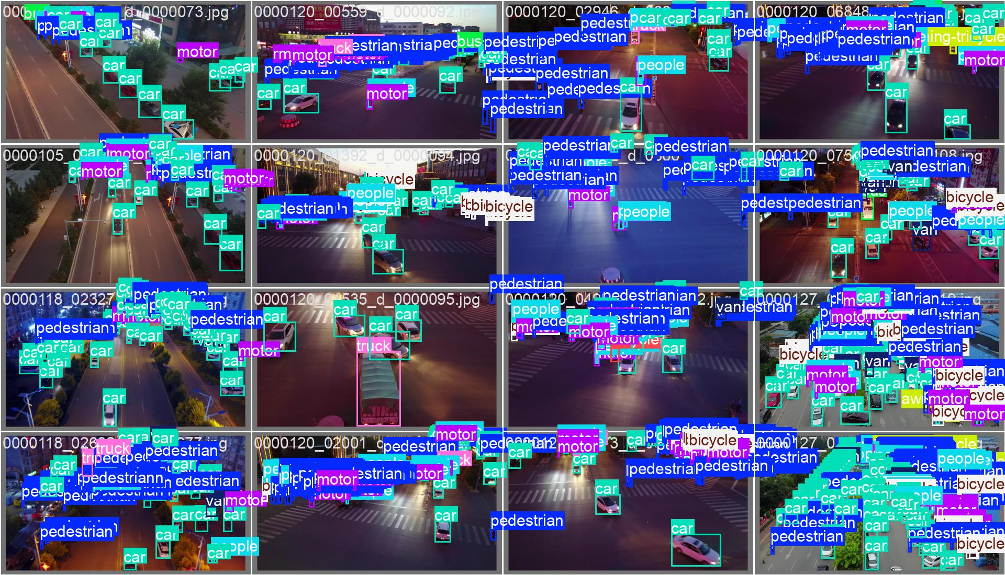
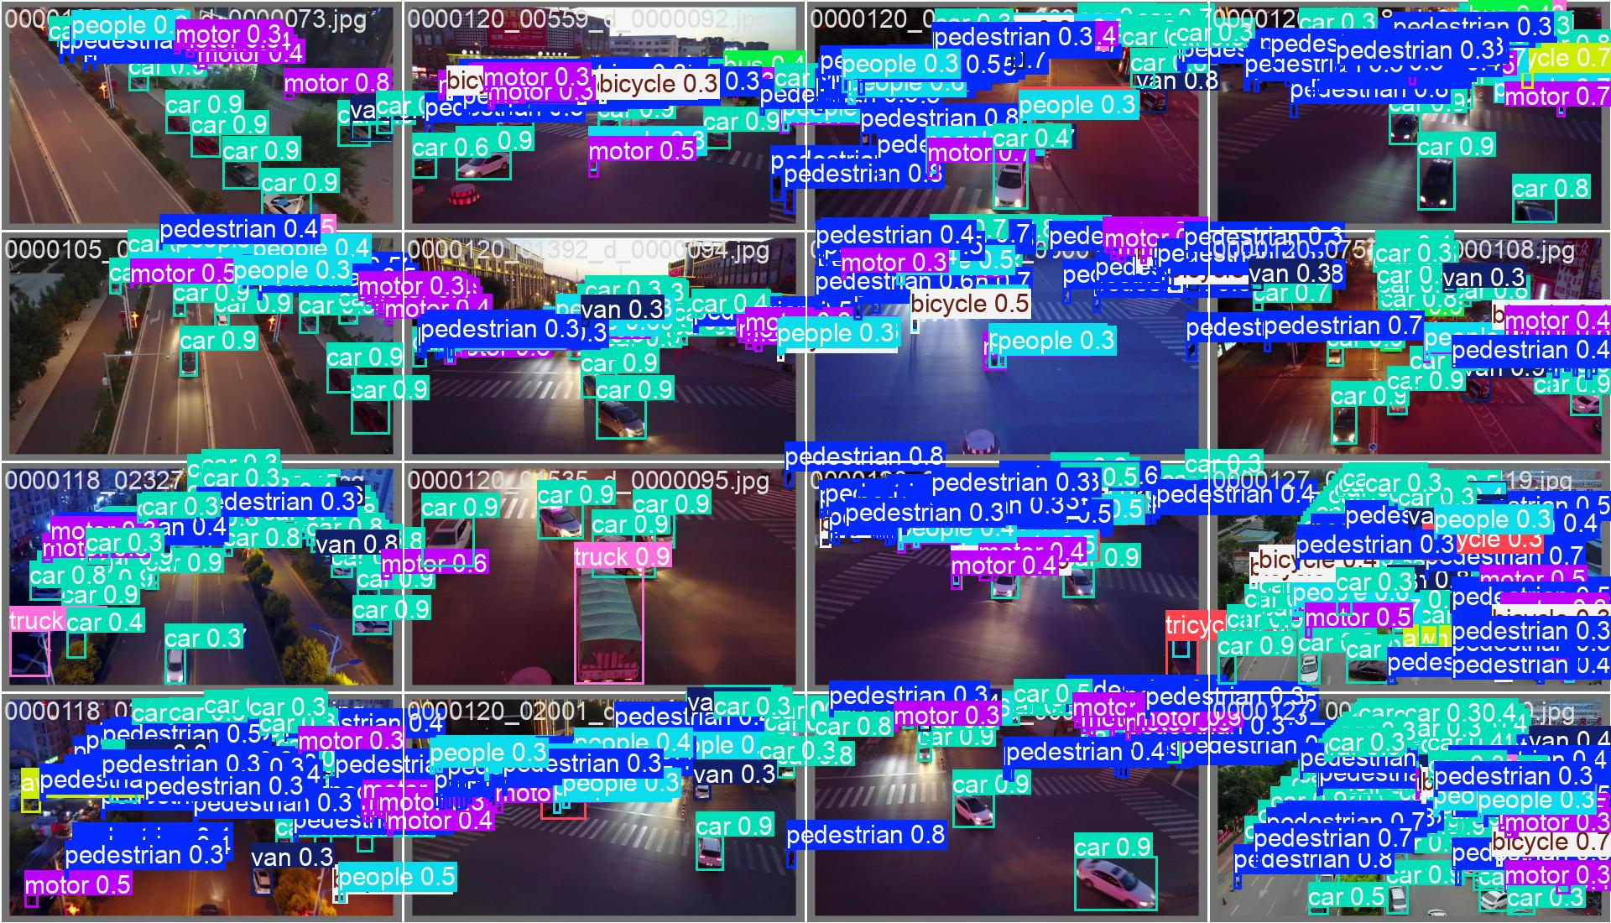
Dataset
Dataset: VisDrone
Images: Contains over 10,209 static images and 288 video clips (261,908 frames).
Annotations: Includes over 2.6 million object instances with bounding boxes and attributes.
Classes: 10 object categories, including pedestrians, people, bicycles, cars, vans, trucks, tricycles, awning-tricycles, buses, and motors.

Slide 6
Comparison of YOLOv5, YOLOv11n, and YOLOv11x
YOLOv11n: Architecture Features:
A lightweight version, ideal for edge devices and real-time tasks.
Backbone includes an improved Focus module for efficient feature extraction.
Uses Anchor-Free dynamic assignment mechanism.
Activation function: Mish, which smooths gradients and improves training stability.
Structure:
Backbone: 25 layers
Neck: 7 layers (enhanced FPN + PAN)
Head: 3 layers
YOLOv11x: Architecture Features:
High-capacity model designed for tasks requiring high precision.
Deeper backbone with CBAM (Convolutional Block Attention Module) for optimized feature extraction.
Enhanced FPN + PAN for richer multi-scale feature fusion.
Head employs a multi-layer prediction structure for improved detection performance.
Structure:
Backbone: 35 layers
Neck: 10 layers (enhanced FPN + PAN)
Head: 5 layers (more complex prediction layers)
YOLOv5:
Architecture Features:
Lightweight design, suitable for resource-constrained scenarios.
Utilizes CSPNet to reduce redundant gradient calculations and improve efficiency.
Anchor-based model with fixed anchor boxes.
Activation function: LeakyReLU.
Structure:
Backbone: 20 layers
Neck: 5 layers (FPN + PAN modules)
Head: 3 layers (prediction layers)

Slide 7
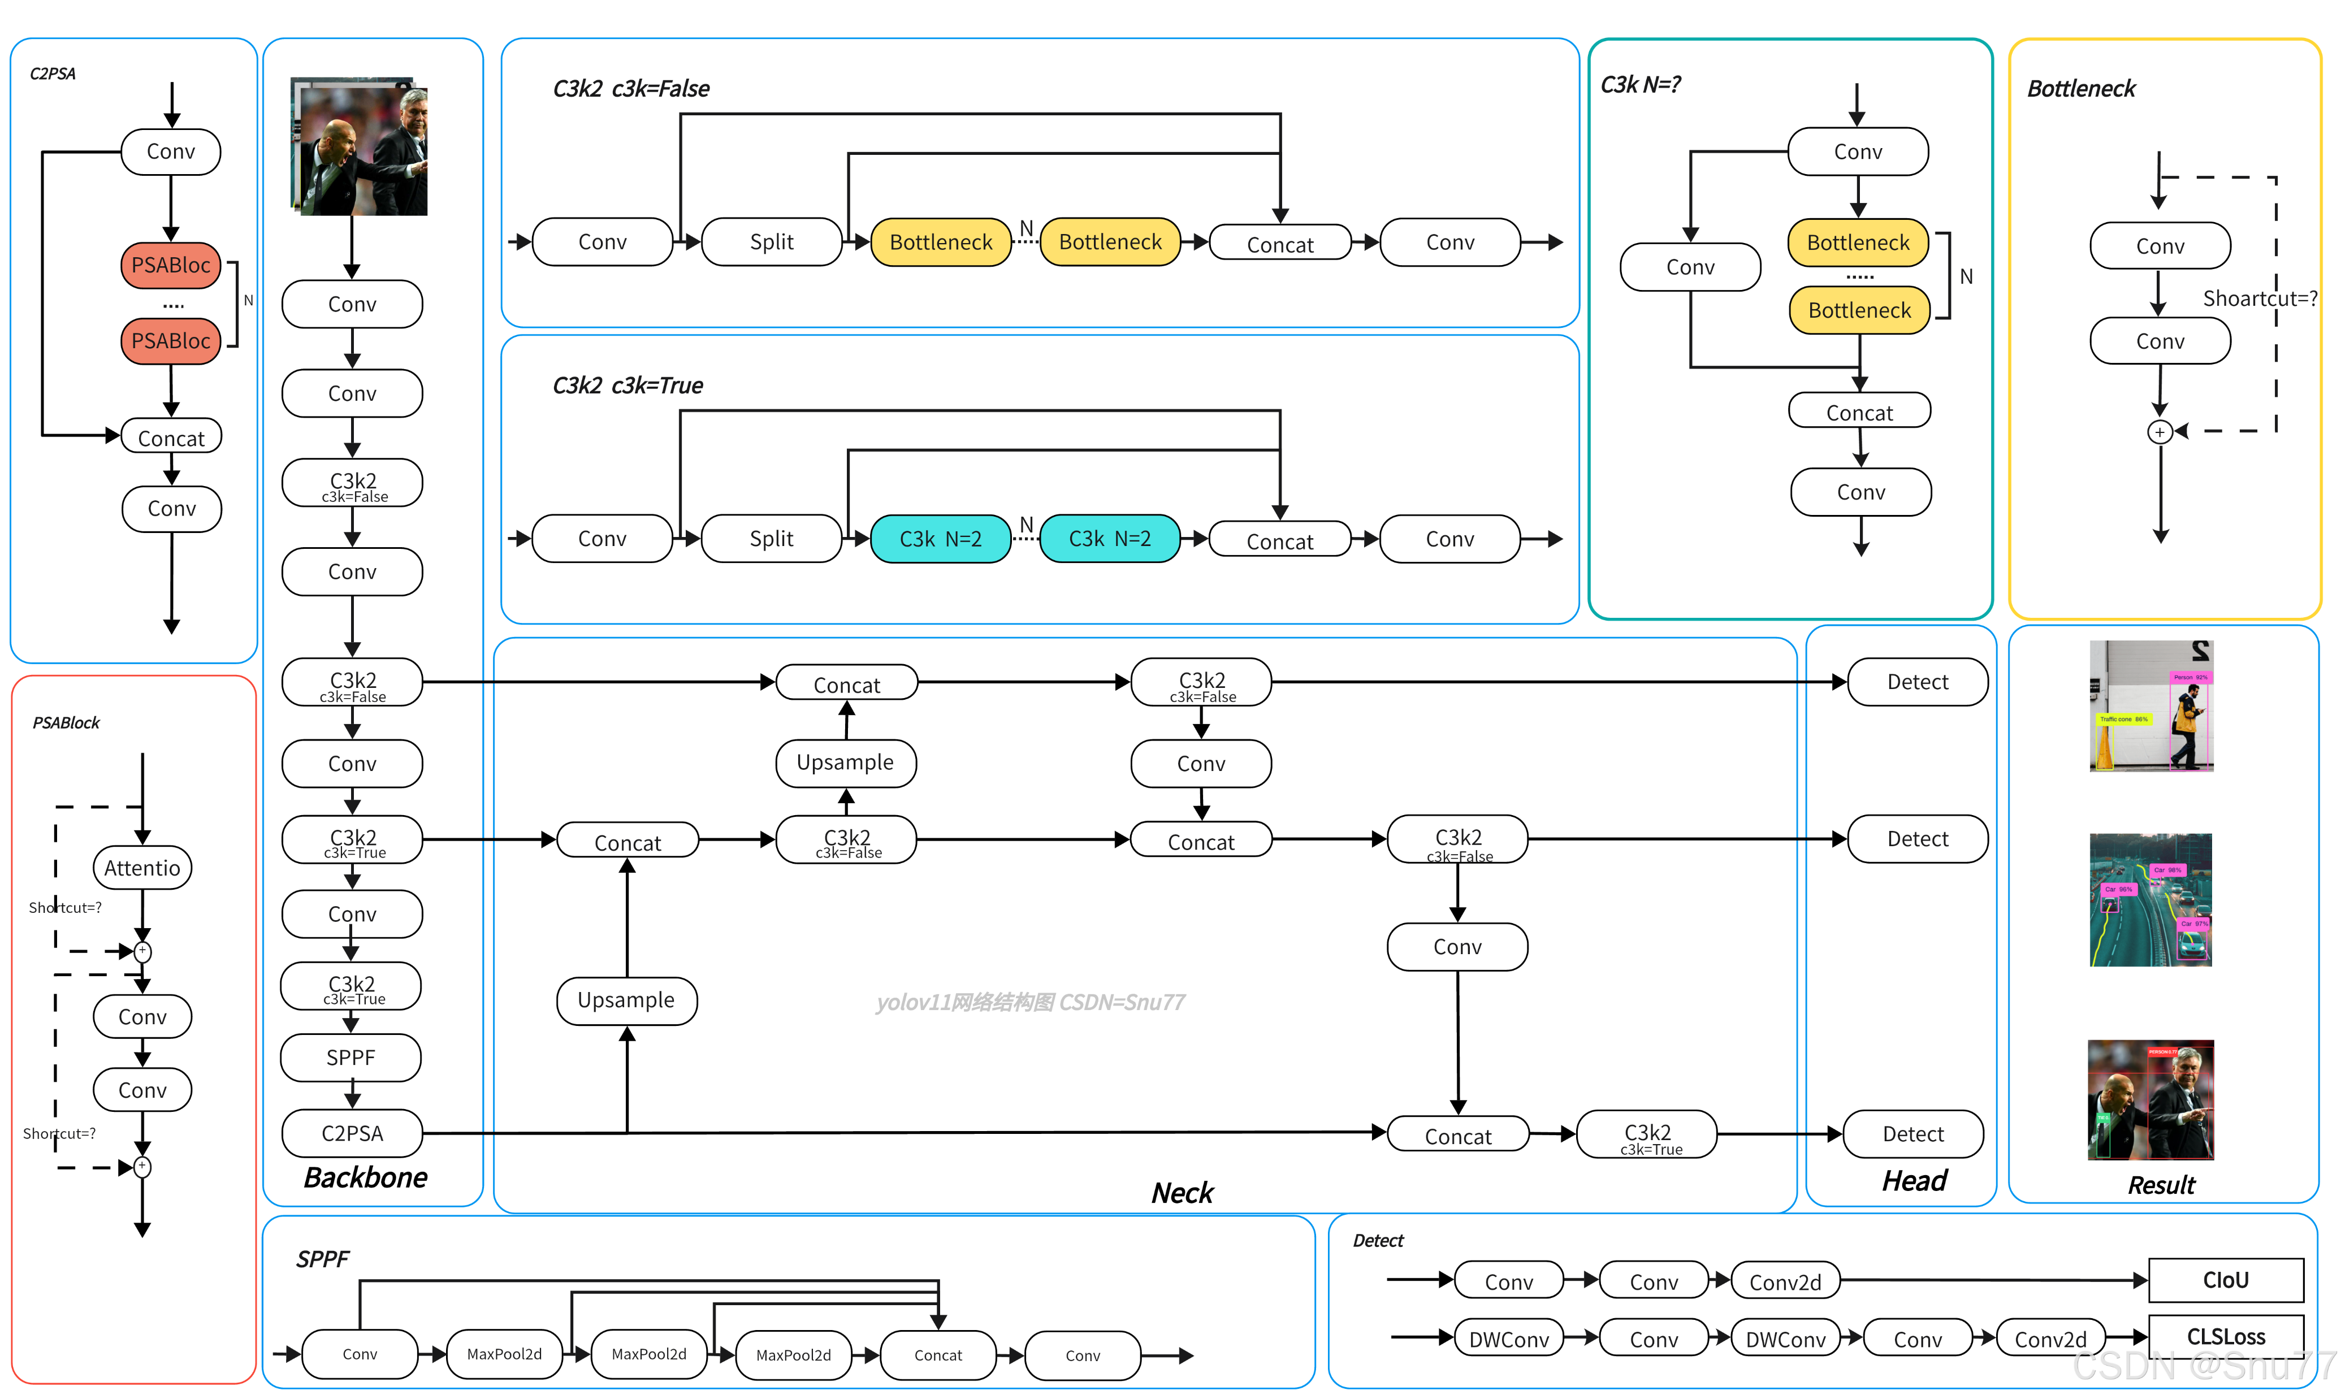
Yolov11 Architecture
Starting from YOLOv8, attention mechanisms such as CBAM (Convolutional Block Attention Module) have been incorporated into the architecture, significantly improving the model's capability to focus on salient regions of the image and enhancing overall detection accuracy by leveraging spatial and channel-wise attention features.
Reference: Diagram source: https://blog.csdn.net/java1314777/article/details/142665078

Slide 8
Evaluation
Metrics:
YOLOv11x outperformed YOLOv11n in accuracy and stability.
Real-time system achieved consistent tracking with live video inputs.
Results:
Detected and tracked objects like cars and pedestrians.
Smooth performance despite challenges.

Slide 9
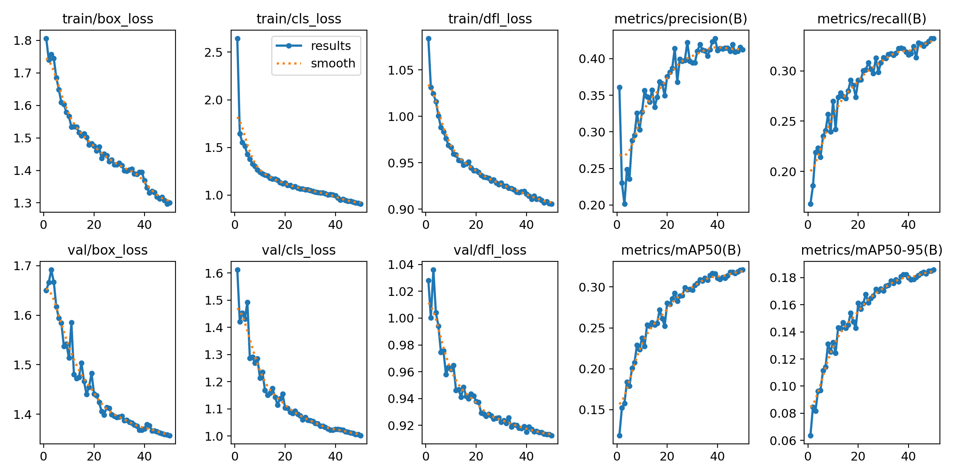
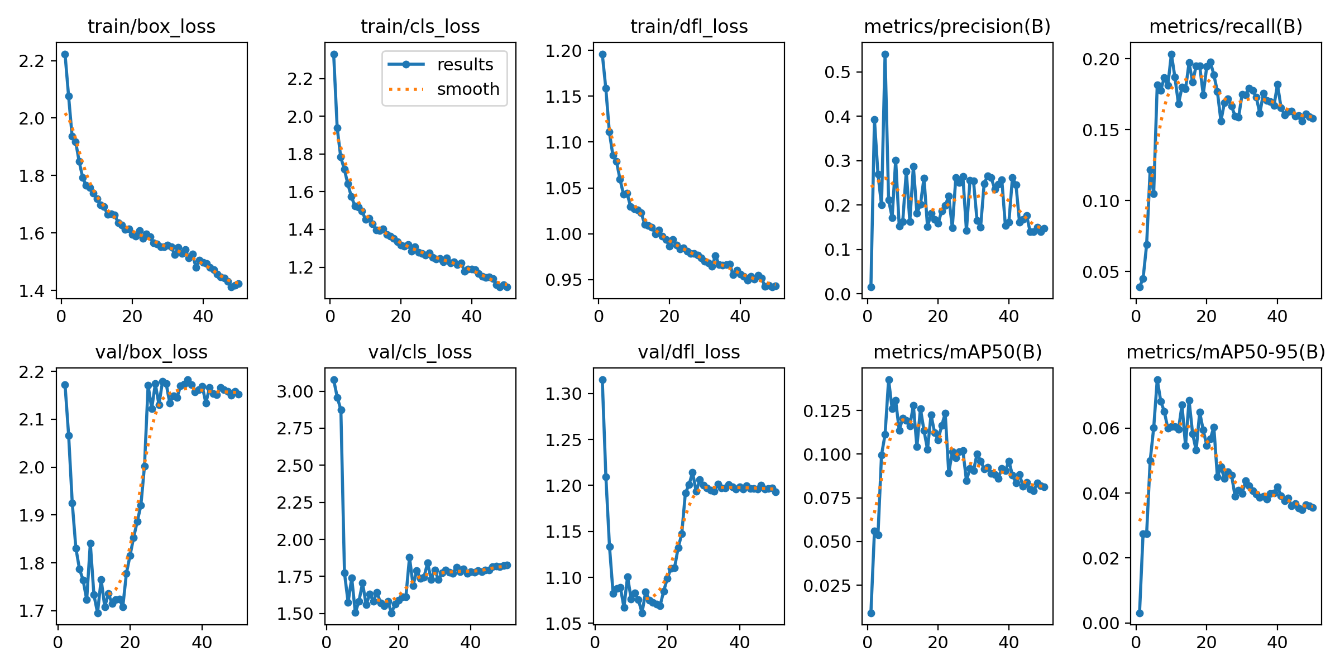
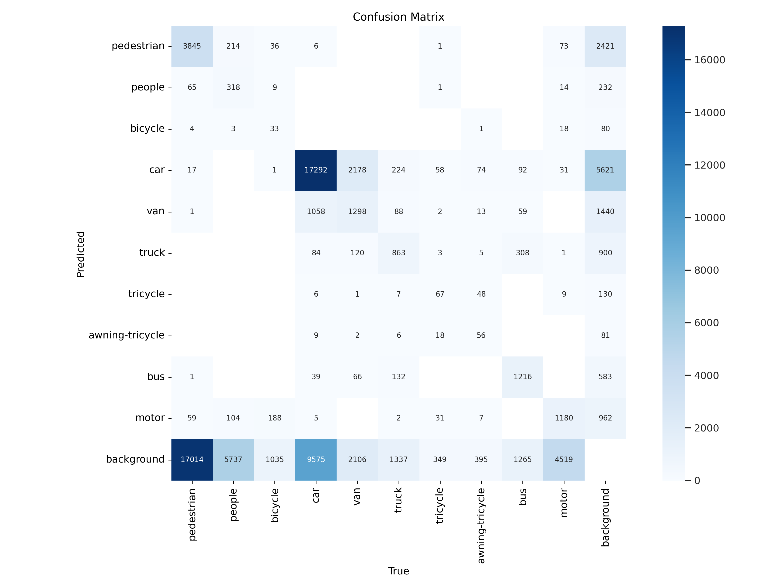
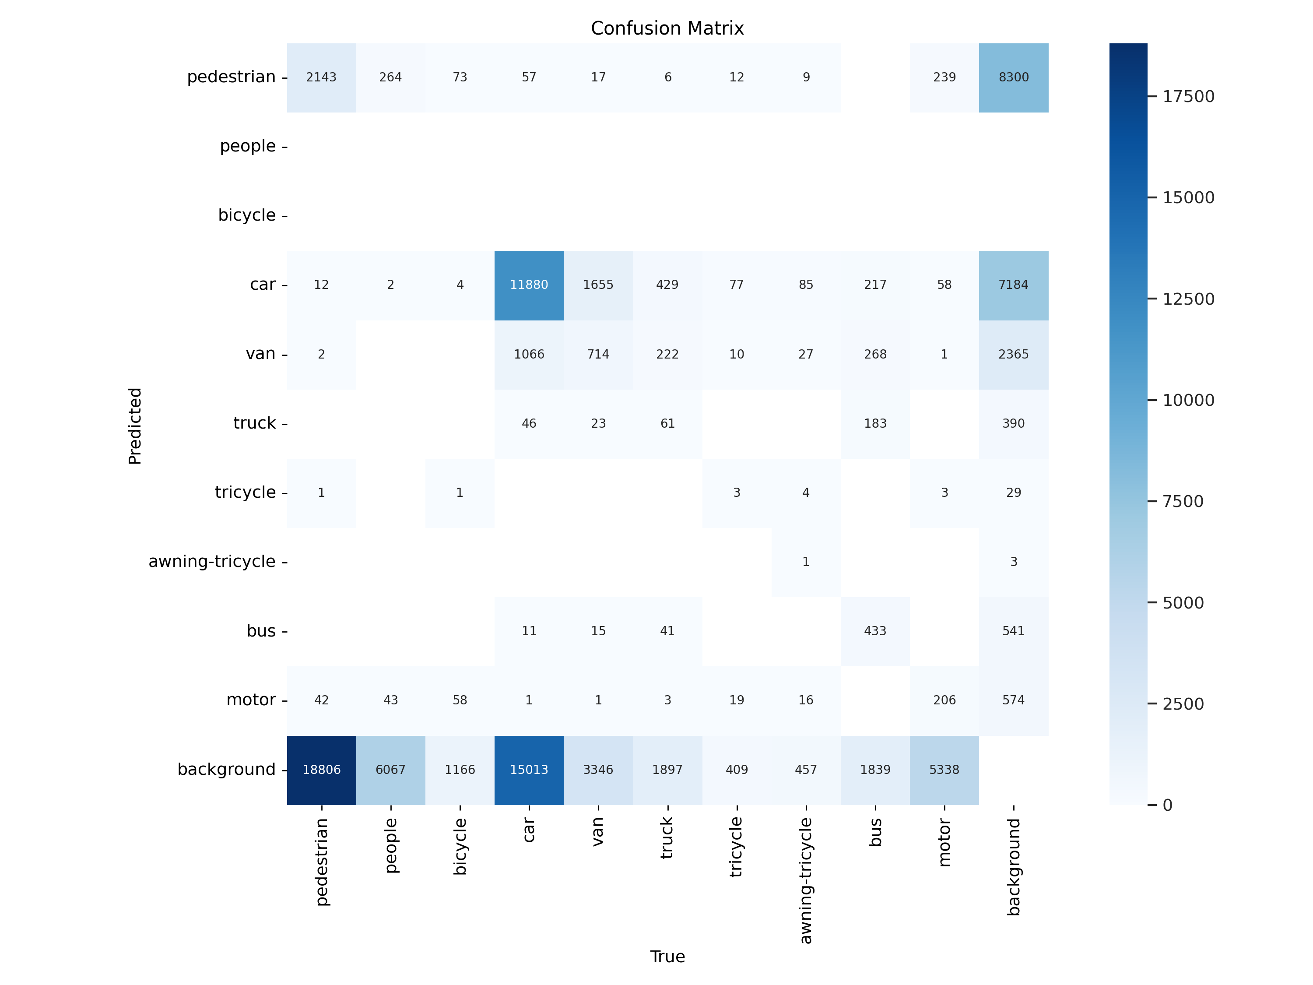
Result Diagrams
Yolov11n default result with SGD optimizer
A little bit better than default.
Yolov11n default result with Adam optimizer

Slide 10
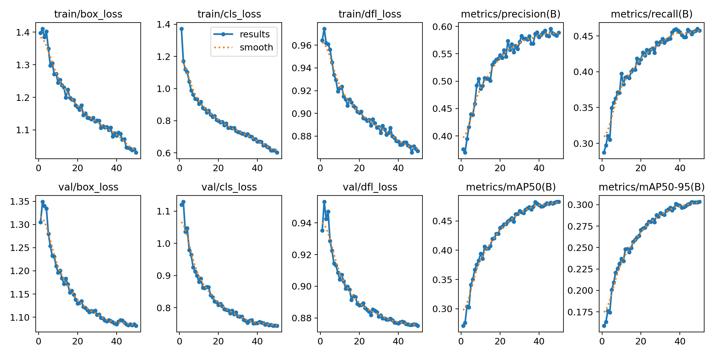
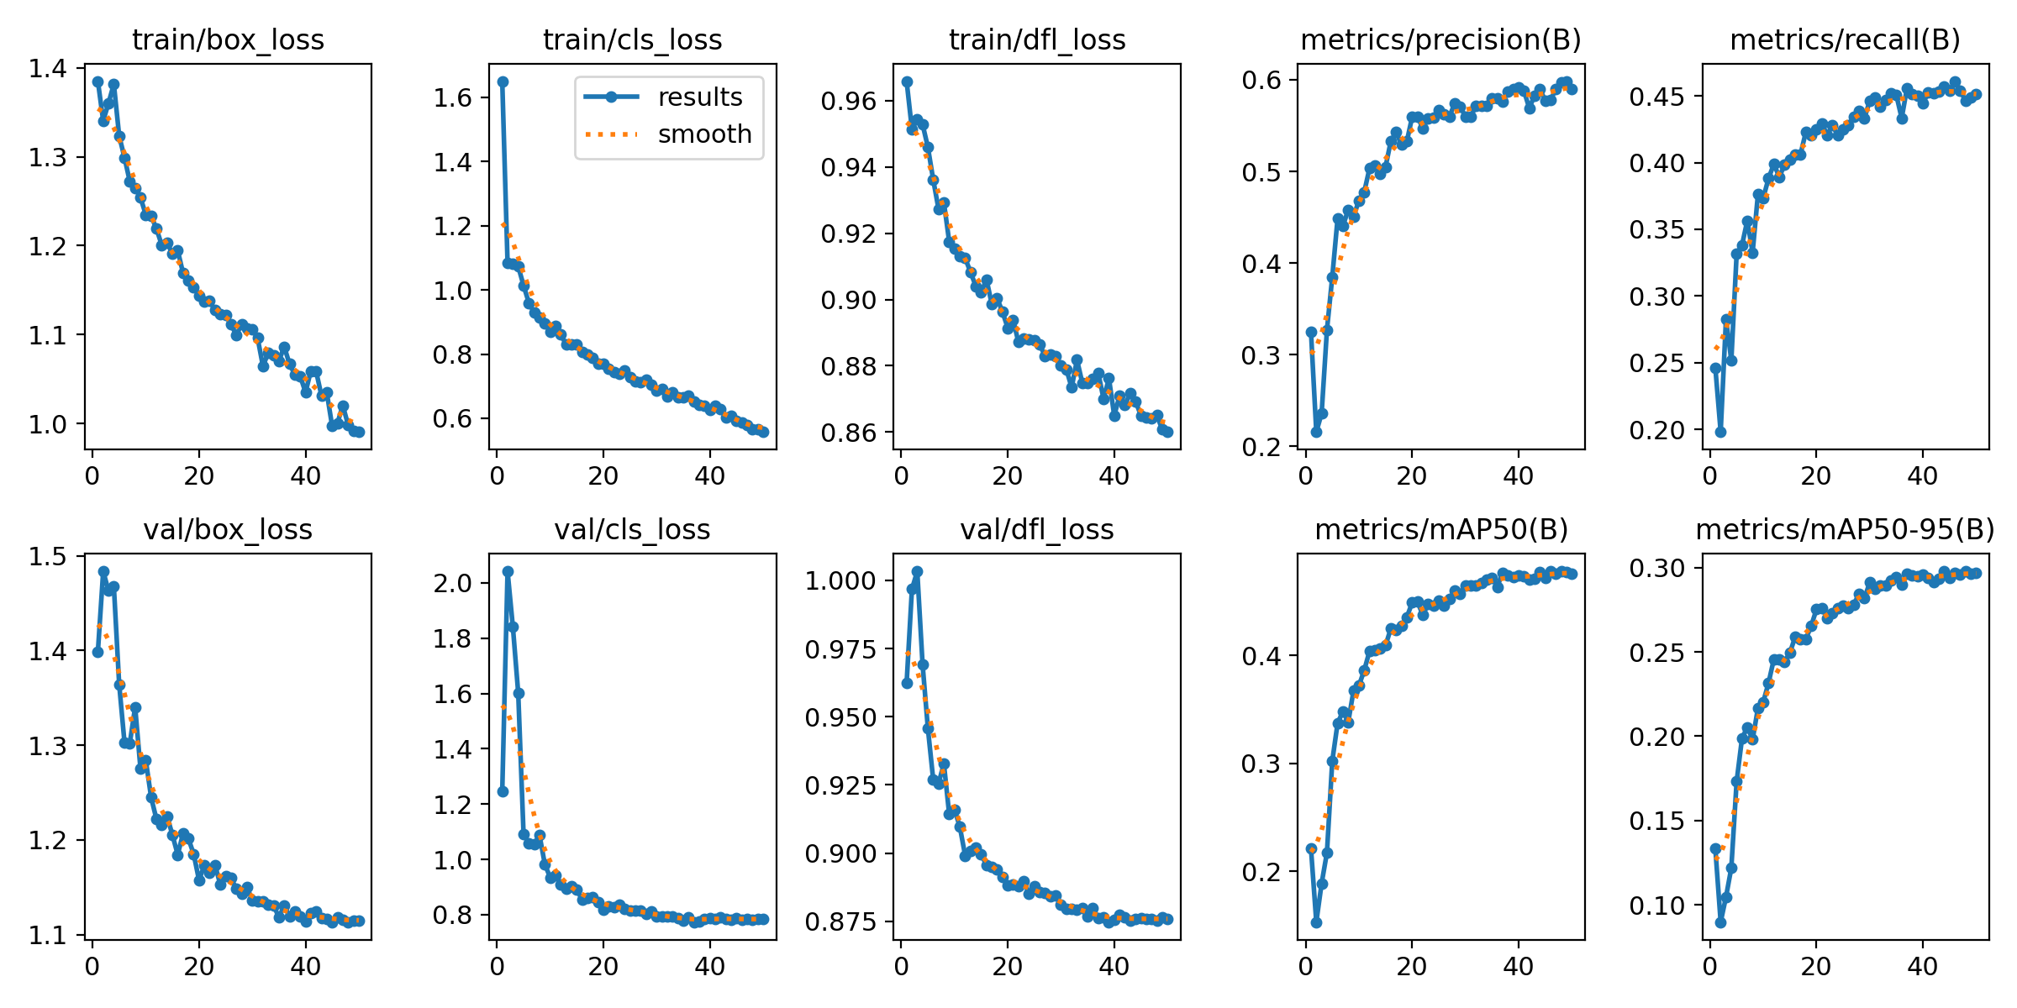
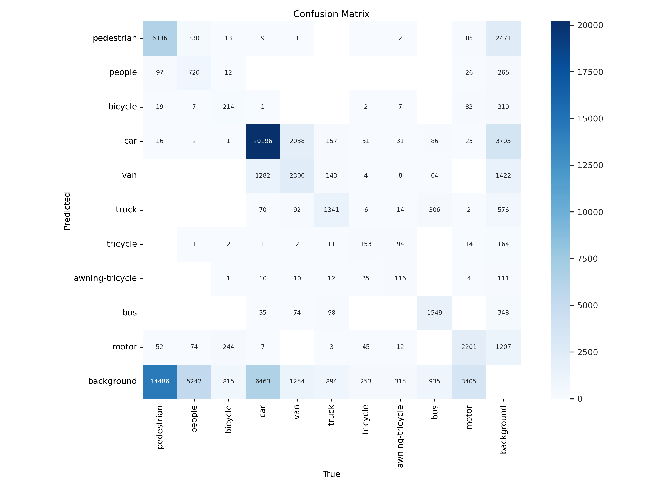
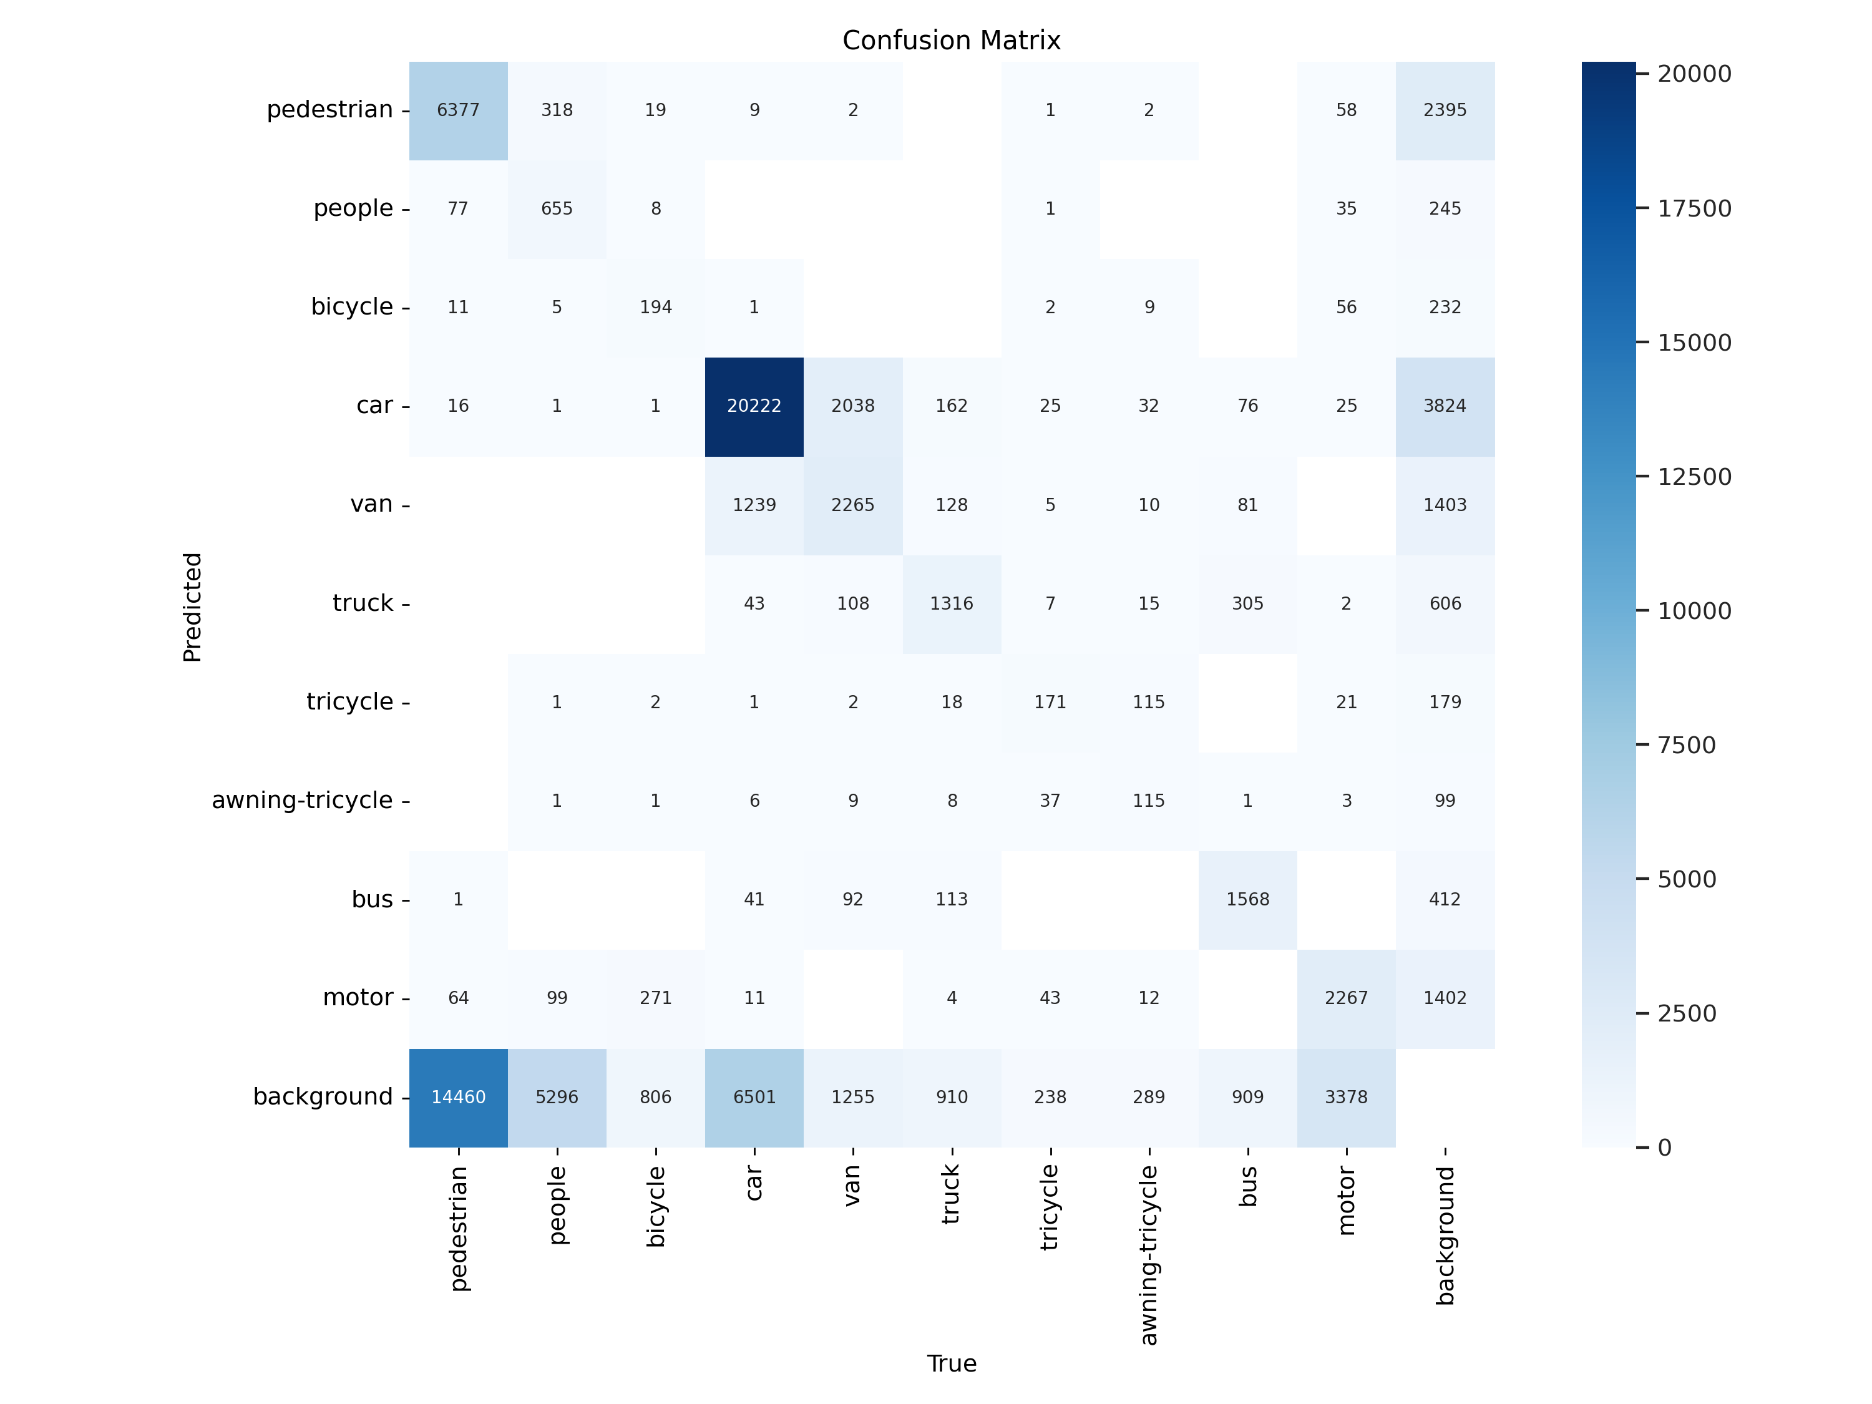
Result Diagrams
Yolov11x default:
Batch size: 16
Learning rate: 0.0001
Img-size: 640
Optimizer: SGD
Yolov11x with hyperparameters modified:
Batch size 84
Learning rate: 0.0001
Img-size: 720
Optimizer: SGD

Slide 11
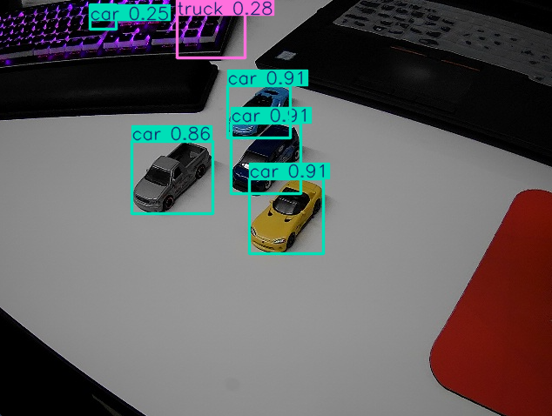
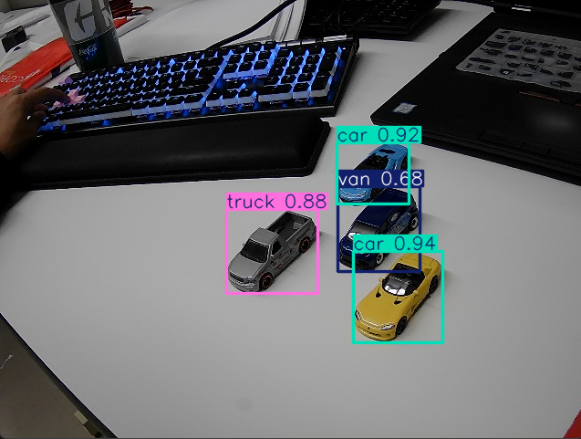
Real-time detection comparison of n-model and x-model results
Yolov11n model result
Yolov11x model result

Slide 12
Future Work
Enhance Accuracy:
Explore advanced feature extraction techniques such as 1D CNNs to improve object detection capabilities.
Address dataset class imbalance, particularly for underrepresented categories like trucks, to minimize misclassification.
Real-World UAV Deployment:
Integrate the detection system with UAV hardware for in-field testing and validation under varying environmental conditions.

Slide 13
Real-Time Detection Implementation
Developed in three stages:
Basic Detection: Bounding box predictions using YOLO.
Object Tracking: Added trajectory visualization.
Object Locking: Interactive object selection with directional guidance.

Slide 14
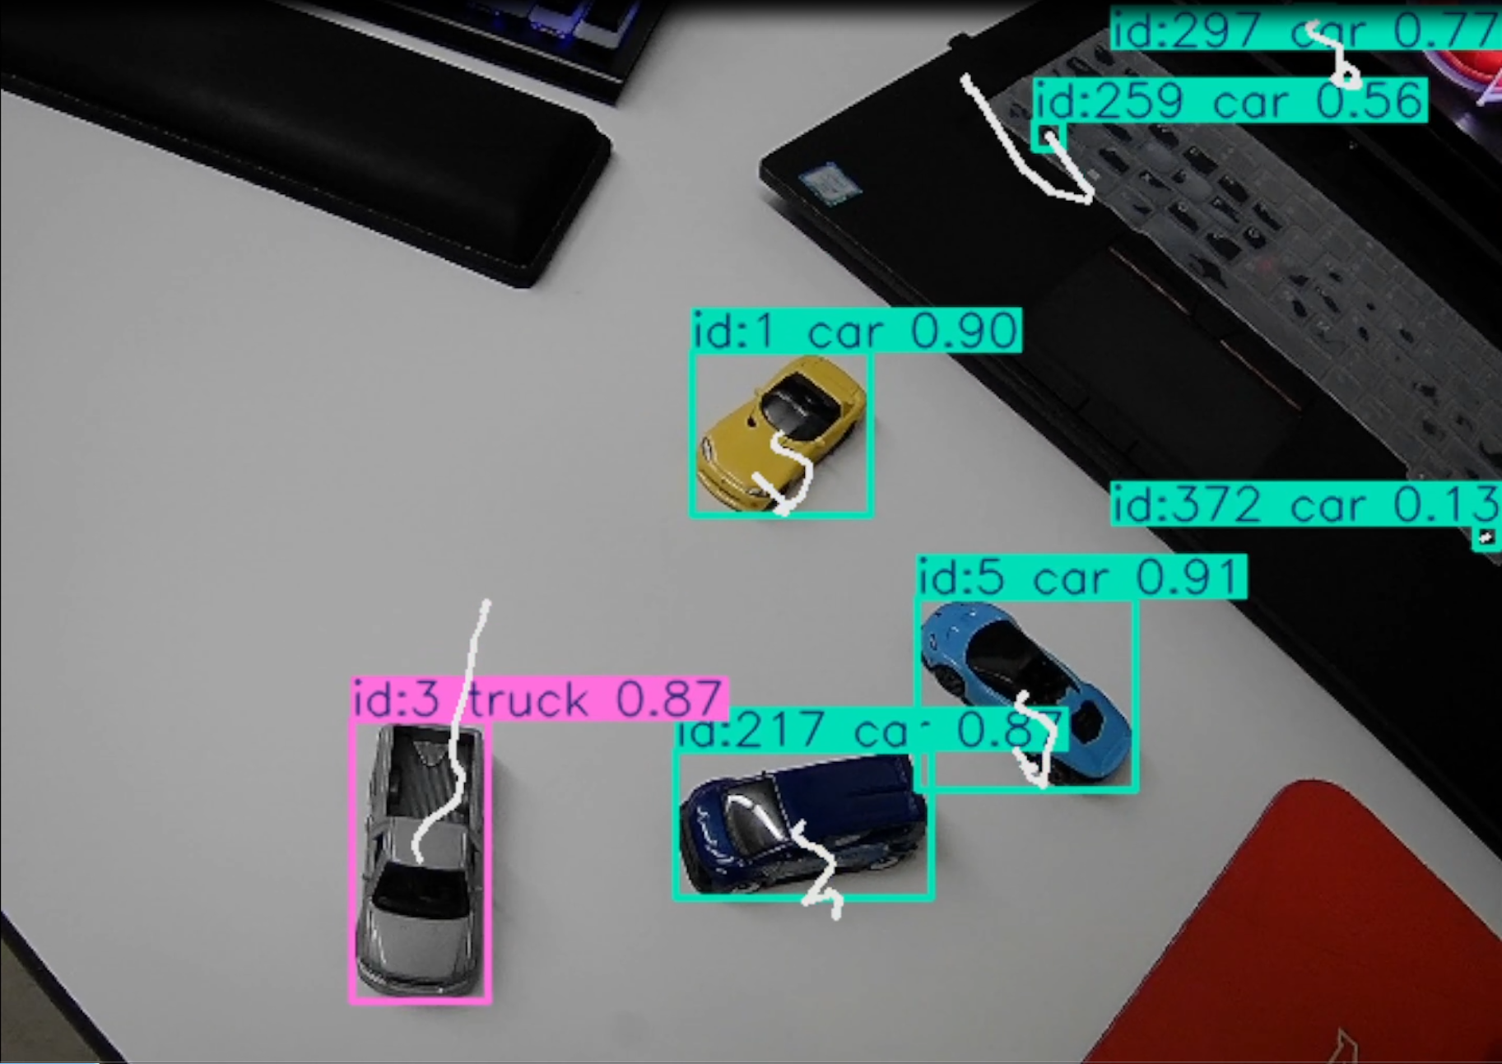
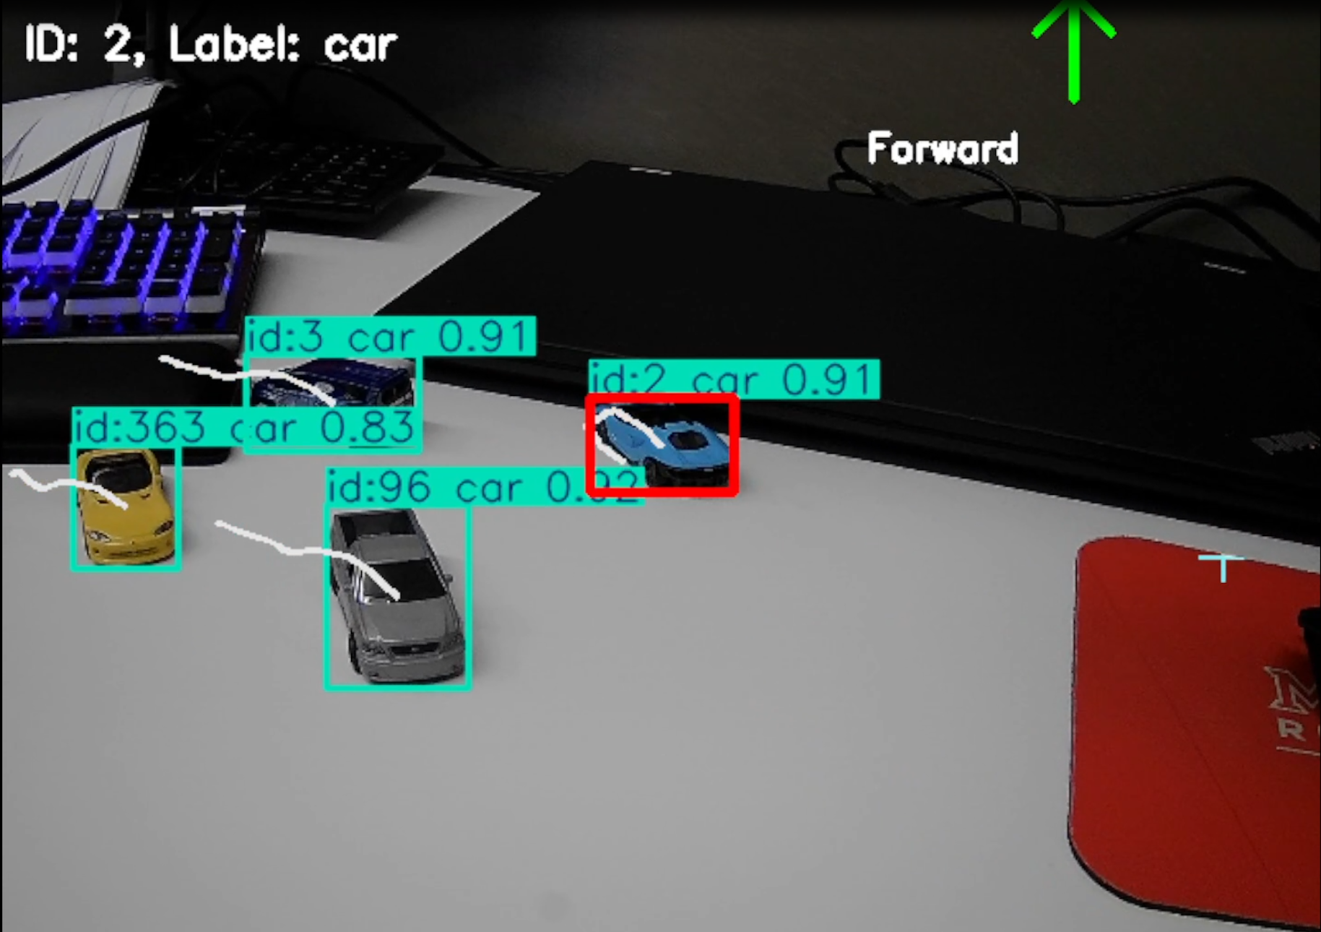
Realtime Sample and Demo
Object Tracking
Object Locking

